Slide 1
Introduction to Java for Business BU350.700.51 Spring I 2025
Using Some Built-In Classes

Slide 2
Built-In Java Classes
Java has an extensive library of built-in classes that can be used to help programmers quickly create programs
Many classes are automatically available & others can be easily incorporated by importing
Programmers can also build their own customized classes from scratch or by incorporating built-in classes

Slide 3
Some Built-In Java Classes
String
Implements character strings that need little/no change during program execution
StringBuffer
Implements character strings that need to undergo frequent change during program execution
GregorianCalendar
Calendar, date & time manipulation

Slide 4
Syntax For Creating Objects
Variable name
Class name
Initialization parameters

Slide 5
Creating Objects
Initializes a String object called s & initializes it to “Hello World”

Slide 6
Manipulating Objects
Objects are manipulated by accessing their state variables and executing their methods
Most classes only allow state variables to be manipulated via methods
“dot” operator

Slide 7
Creating a StringBuffer Object

Slide 8
Creating a StringBuffer Object

Slide 9
Manipulating StringBuffer Objects
// StringBuffer objects are mutable, so you can
// add, delete, and replace parts of the object.
public class StringBufferDemo1
{
public static void main( String [] args )
{
StringBuffer myStringBuffer = new StringBuffer("I like Java");
// You can insert characters and strings into a StringBuffer object
myStringBuffer.insert(7, "C++ and ");
System.out.println();
System.out.println( myStringBuffer );
// You can replace characters snd strings in a StringBuffer object
myStringBuffer.replace(7, 9, "HTML" );
System.out.println( myStringBuffer );
}
}

Slide 10
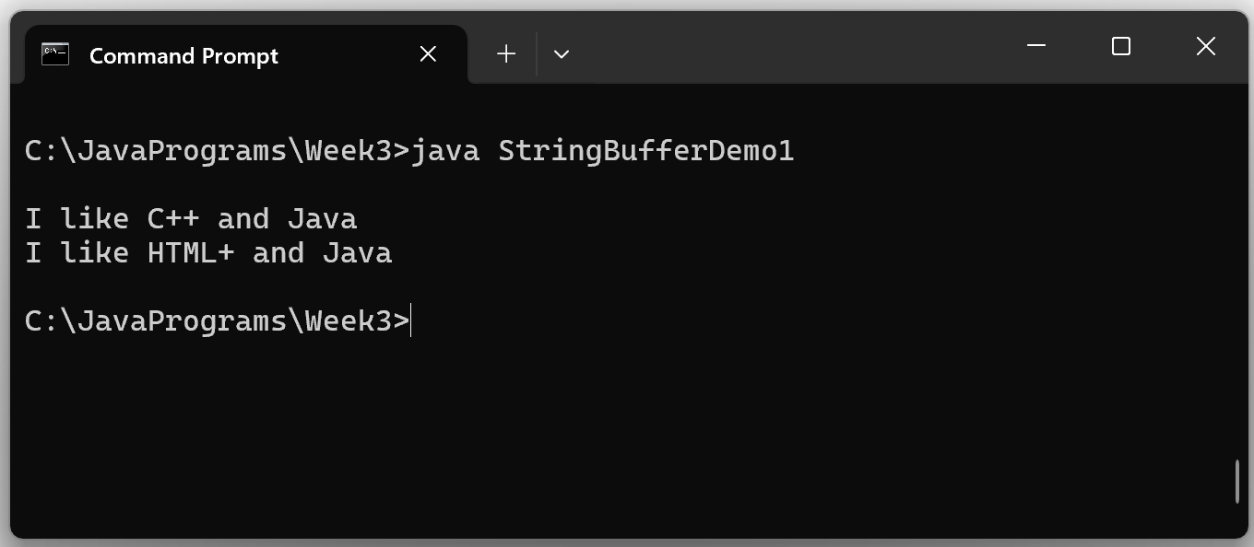
Manipulating StringBuffer Objects

Slide 11
The Gregorian Calendar Class
Supports date, time, and calendar operations

Slide 12
Gregorian Calendar Objects
import java.util.*;
public class CalendarDemo
{
public static void main( String [] args )
{
GregorianCalendar today;
GregorianCalendar date;
today = new GregorianCalendar();
System.out.print( "\nToday is " ); display( today );
// Initialize date to 1/31/2025 … January has value 0
date = new GregorianCalendar(2025, 0, 31);
System.out.print( "Initializing date to " ); display( date );
date.add(Calendar.DATE, 2);
System.out.print( "Two days later is " ); display( date );
date.add(Calendar.DATE, -1);
System.out.print( "And the day before that is " ); display( date );
}
public static void display( GregorianCalendar d )
{
System.out.println( d.get(Calendar.MONTH) + 1 + "/" +
d.get(Calendar.DATE) + "/" +
d.get(Calendar.YEAR) );
}
}

Slide 13
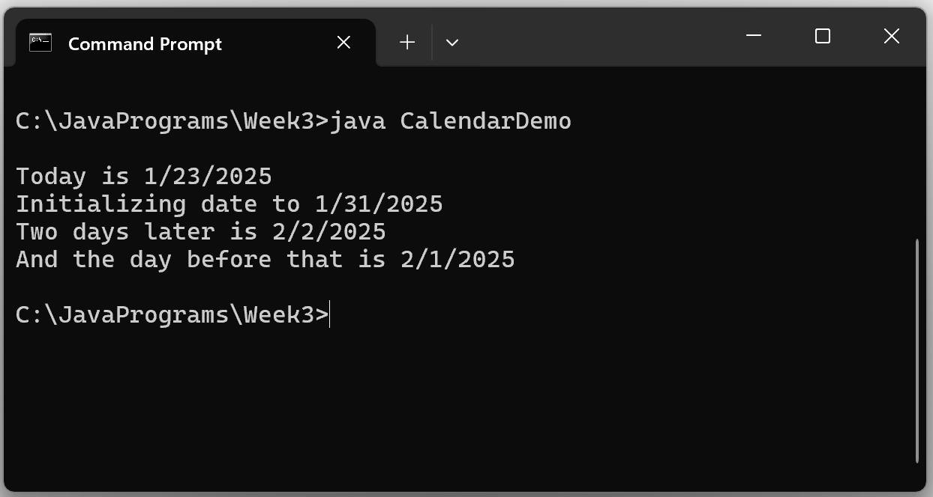
Gregorian Calendar Demo

